Slide 1
HOTEL BOOKING &
OCCUPANCY MANAGER
Java-Based Room Reservation & Hotel Management System
PROJECT DETAILS
Student Name: 1. M.Srikari [2620030683]
2.G.Sanjana [2620030234]
Faculty Guide: V.GopiKrishna

Slide 2
1. Introduction
2
Hotel management involves reservations, room allocation, guest check-in, check-out, and billing.
A manual process can make room status and occupancy difficult to track.
This project develops a simple Java-based system to organize these operations.
The system demonstrates fundamental Java control statements in a real-world application.
ROOM BOOKING
Reserve a vacant room.
BILLING
Generate guest bill.
Hotel Booking & Occupancy Manager

Slide 3
2. Problem Statement
3
Managing room reservations manually can lead to errors and delays.
Staff need to know whether a room is vacant or occupied.
Different room categories require clear selection and handling.
Guest operations such as check-in and check-out must update room status correctly.
Billing and occupancy information should be available in an organized form.
VACANCY
Is the room available?
CATEGORY
What type of room?
BILL
What amount is due?
Hotel Booking & Occupancy Manager

Slide 4
3. Objectives
4
1.
2.
Manage room booking
Check room type
Reserve available rooms efficiently.
Select category using switch.
3.
Manage guests
4.
Generate bills
Handle check-in and check-out.
Calculate charges clearly.
5.
6.
Track occupancy
Apply Java concepts
Display current room status.
Use if-else, switch, for and while.
Hotel Booking & Occupancy Manager

Slide 5
4. Existing System
5
MANUAL RECORDS
LIMITATIONS
NEED FOR IMPROVEMENT
• Paper registers or spreadsheets
• Room status updated manually
• Billing calculations may be done separately
• Occupancy information is not always immediate
• Higher chance of data-entry errors
• Slower reservation process
• Difficult to track room availability
• Repetitive work for staff
• Centralized room information
• Faster booking and check-out
• Automatic status updates
• Simple occupancy reporting
Hotel Booking & Occupancy Manager

Slide 6
5. Proposed System
6
Develop a menu-driven Java application for hotel room management.
Store room number, category, availability, guest details, and charges.
Use control statements to manage different hotel operations.
Update room status automatically during booking and check-out.
Generate a simple bill and display an occupancy report.
1
2
3
4
5
Book
Check-in
Stay
Bill
Check-out
Hotel Booking & Occupancy Manager

Slide 7
6. System Architecture
7
USER / RECEPTIONIST
Inputs guest and room details
JAVA MENU & CONTROL LOGIC
if-else • switch • for • while
HOTEL MANAGEMENT MODULES
Booking • Check-in • Check-out • Billing
ROOM & GUEST DATA
Room status • Category • Guest details • Charges
REPORTS / OUTPUT
Available rooms • Bill • Occupancy report
Hotel Booking & Occupancy Manager

Slide 8
7. Functionalities
8
Room Booking
Room Category
Guest Operations
Select a room and reserve it if vacant.
Choose Single, Double, Deluxe, etc.
Perform check-in and check-out.
Bill Generation
Available Rooms
Occupancy Report
Calculate room charges and display bill.
Use a for loop to list vacant rooms.
Show occupied and available rooms.
Hotel Booking & Occupancy Manager

Slide 9
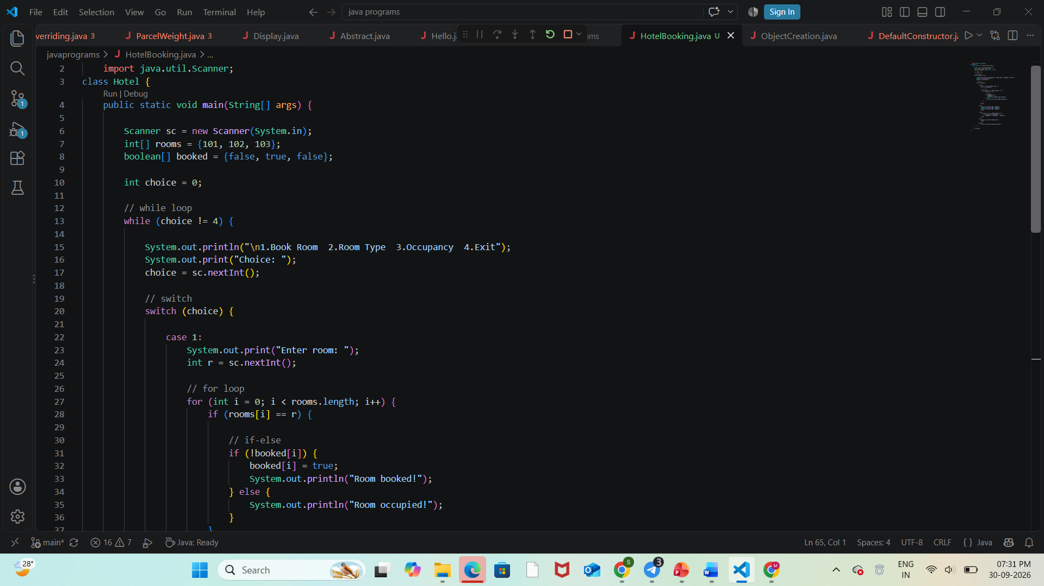
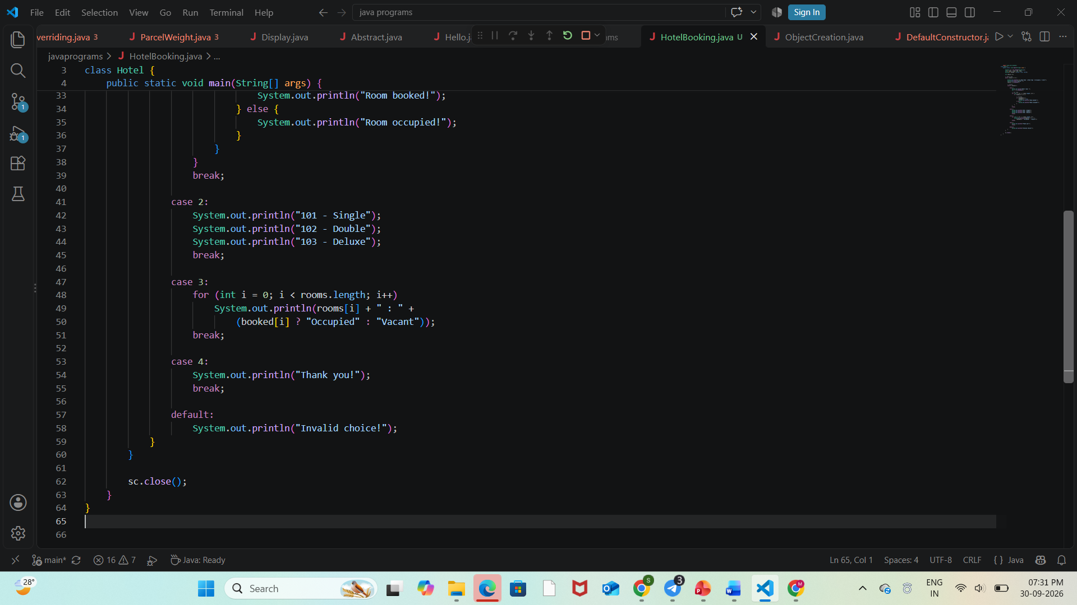
8. Implementation – Java Code Screenshots
9

Slide 10
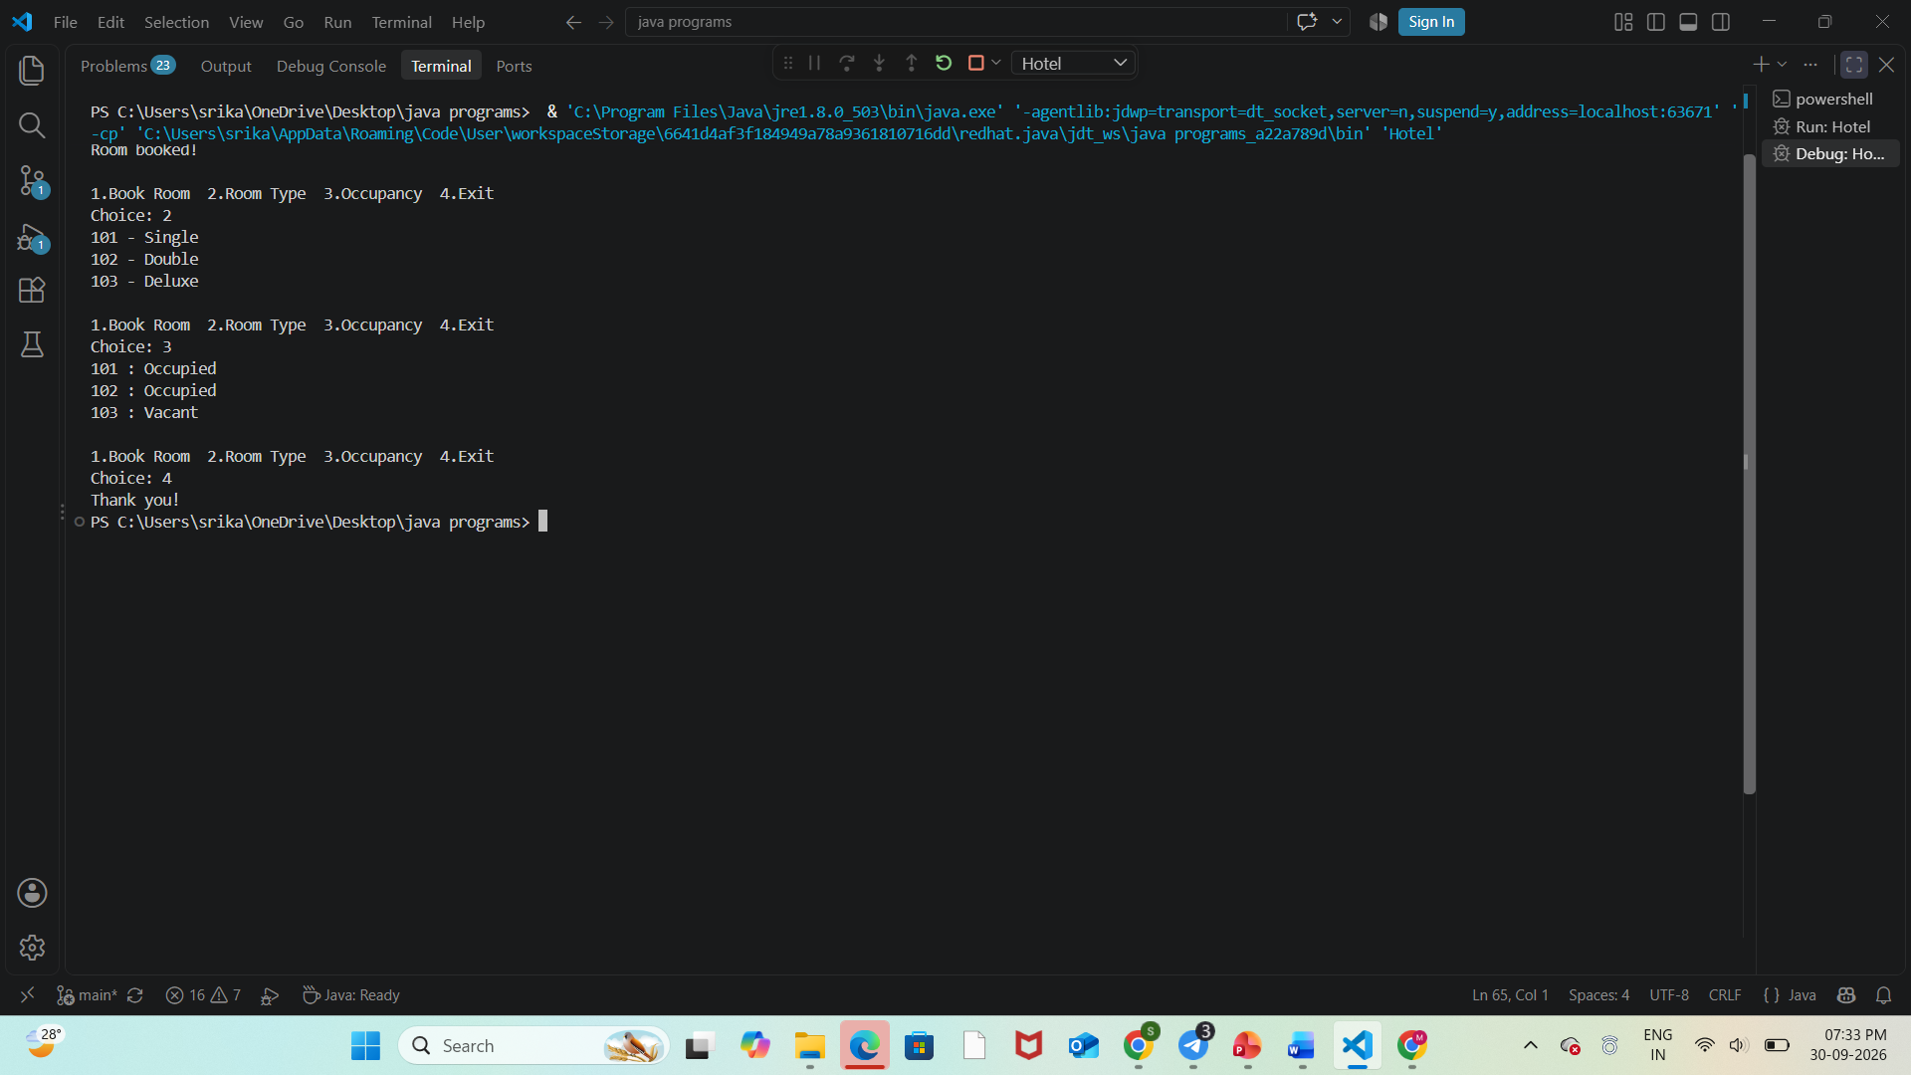
9. Output Screenshots
10
BOOKING OUTPUT
Room 102 → Double → Occupied
BILL OUTPUT
Room Charge: ₹2,500 | Total: ₹2,500
OCCUPANCY OUTPUT
Total: 10 | Occupied: 4 | Vacant: 6
Hotel Booking & Occupancy Manager

Slide 11
10. Future Scope
11
Connect the application to a database such as MySQL.
Add a graphical user interface (GUI) for reception staff.
Support online booking and cancellation.
Add payment gateway integration and digital invoices.
Send booking confirmations and reminders.
Generate advanced reports for occupancy and revenue.
Add login and role-based access for staff and administrators.
DATABASE
Store records securely.
ONLINE BOOKING
Allow remote reservations.
SMART REPORTS
Analyze occupancy & revenue.
Hotel Booking & Occupancy Manager

Slide 12
11. Conclusion
12
The Hotel Booking & Occupancy Manager provides a simple approach to hotel room management.
It handles booking, room category selection, guest operations, billing, and occupancy reporting.
The project demonstrates practical use of Java control statements.
Using automation reduces repetitive manual work and makes room status easier to track.
The project can be extended into a complete database-driven hotel management application.
BOOK • MANAGE • REPORT
Hotel Booking & Occupancy Manager

Slide 13
THANK YOU
Hotel Booking & Occupancy Manager

